Slide 1
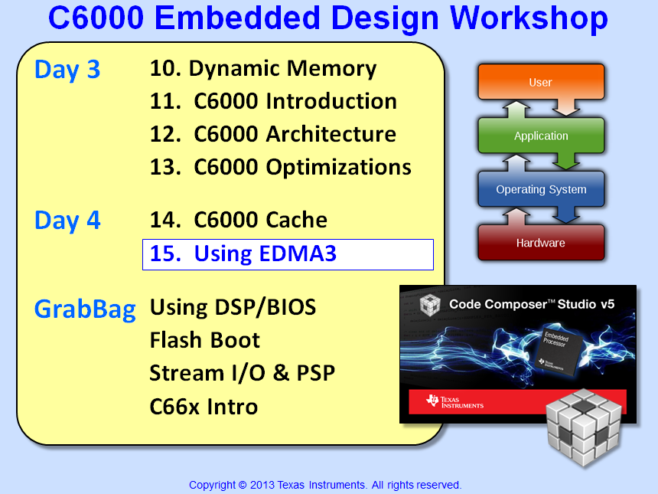

Slide 2
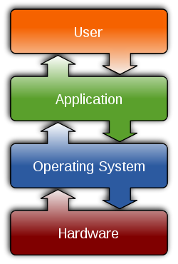
Outline
Overview
Terminology
Examples
Synchronization
Indexing
Events – Transfers - Actions
EDMA Interrupt Generation
Linking
Chaining
Channel Sorting
Architecture & Optimization
Quiz (No Lab)

Slide 3

What is “DMA” ?
When we say “DMA”, what do we mean? Well, there are MANY forms of “DMA” (Direct Memory Access) on this device:
EDMA3 – “Enhanced” DMA handles 64 DMA CHs and 4 QDMA CHs
DMA – 64 channels that can be triggered manually or by events/chaining
QDMA – 8 channels of “Quick” DMA triggered by writing to a “trigger word”
EDMA3
EVTx
Q0
TC0
Chain
DMA
64
Switched Central Resource
Q1
TC1
SCR
Manual
TC2
Q2
Trigger Word
QDMA
4
Q3
TC3
IDMA – 2 CHs of “Internal” DMA (Periph Cfg, Xfr L1 ↔ L2)
IDMA
L1D
L2
Ch0
PERIPH
L1
Ch1
L2
Peripheral “DMA”s – Each master device hooked to the Switched Central Resource (SCR) has its own DMA (e.g. SRIO, EMAC, etc.)
Notes:
It is important to point out the different definitions of “DMA” and when these items are covered in the workshop. Chapter 5 is primarily focussed on the 64-channel DMA as part of the EDMA3 module. Chapter 6 also covers details on EDMA3 and contains 3 slides on QDMA. Chapter 9 – Optimizations – will cover IDMA.

Slide 4
Multiple DMA’s : EDMA3 and QDMA
VPSS
EDMA3
(System DMA)
C64x+ DSP
L1P
L1D
DMA
(sync)
QDMA
(async)
Master Periph
L2
DMA
Enhanced DMA (version 3)
DMA to/from peripherals
Can be sync’d to peripheral events
Handles up to 64 events
QDMA
Quick DMA
DMA between memory
Async – must be started by CPU
4-16 channels available
Both Share (number depends upon specific device)
128-256 Parameter RAM sets (PARAMs)
64 transfer complete flags
2-4 Pending transfer queues
Notes:
DM6437 – 128 PSETS, 8 QDMA channels, 3 Queues, 64 TCCs
DM6446 – 128/8/2/64
6455 – 256/4/4/64

Slide 5
Multiple DMA’s : Master Periphs & C64x+ IDMA
VPSS
EDMA3
(System DMA)
C64x+ DSP
Front End (capture)
Back End (display)
L1P
L1D
DMA
(sync)
QDMA
(async)
Master Periph’s
USB  ATA
Ethernet
VLYNQ
IDMA
L2
Master Peripherals
VPSS (and other master periph’s) include their own DMA functionality
USB, ATA, Ethernet, VLYNQ share bus access to SCR
IDMA
Built into all C64x+ DSPs
Performs moves between internal memory blocks and/or config bus
Don’t confuse with iDMA API
Notes:  Both ARM and DSP can access the EDMA3  Only DSP can access hardware IDMA

Slide 6
SCR & EDMA3
M
S
Master
Slave
32
EDMA3
SCR = Switched Central Resource
L3
McASP
TC0
CC x2
TC1
McBSP PCI
TC2
L1P
DDR2/3
C64x+ MegaModule
EMAC HPI PCI
L1P Mem Ctrl
PERIPH
EMIF
AET
M
S
Cfg
L2 Mem Ctrl
D
D
L2
IDMA
CPU
S
S
ARM
M
M
L
L
S
M
External Mem Cntl
L1D Mem Ctrl
128
M
S
M
PERIPH =
All peripheral’s
Cfg registers
128
L1D
S
DATA
SCR
32
CFG
SCR
EDMA3 is a master on the DATA SCR – it can initiate data transfers
EDMA3’s configuration registers are accessed via the CFG SCR (by the CPU)
Each TC has its own connection (and priority) to the DATA SCR. Refer to the connection matrix to determine valid connections
Notes:
This is somewhat of a simplification of the SCRs and megamodule diagrams in the datasheet.

Slide 7
Outline
Overview
Terminology
Examples
Synchronization
Indexing
Events – Transfers - Actions
EDMA Interrupt Generation
Linking
Chaining
Channel Sorting
Architecture & Optimization
Quiz (No Lab)

Slide 8
DMA : Direct Memory Access
Goal :
Examples :
Controlled by :
Copy from memory to memory – HARDWARE memcpy(dst, src, len);
Faster than CPU LD/ST. One INT per block vs. one INT per sample
Import raw data from off-chip to on-chip before processing
Export results from on-chip to off-chip afterward
Transfer Configuration (i.e. Parameter Set - aka PaRAM or PSET)
Transfer configuration primarily includes 8 control registers
Original
Data
Block
Copied
Data
Block
DMA
Source
BCNT
Length
ACNT
Destination
Transfer
Configuration
Notes:
For ARM+DSP, resources are shared between ARM and DSP. ARM has some channels, DSP has other channels. If you’re using CE, this is taken care of for you. If you’re NOT using CE, it is up to you to manage resources.

Slide 9
How Much to Move?
Block
Frame
Element
Frame 1
Elem 1
Frame 2
Elem 2
“A” Count
. .
(# of contig bytes)
. .
Elem N
Frame M
“B” Count
“C” Count
Transfer Configuration
Options
Source
B
A
Transfer Count
B Count (# Elements)
A Count (Element Size)
Destination
Index
31
16
15
0
Cnt Reload
Link Addr
C Count (# Frames)
Index
Index
Rsvd
C
31
16
15
0
Let's look at a simple example...

Slide 10
Example – How do you VIEW the transfer?
Let’s start with a simple example – or is it simple?
We need to transfer 12 bytes from “here” to “there”.
8-bit
Note: these are contiguous memory locations
What is ACNT, BCNT and CCNT? Hmmm….
You can “view” the transfer several ways:
ACNT = 1
BCNT = 4
CCNT = 3
ACNT = 2
BCNT = 2
CCNT = 3
ACNT = 12
BCNT = 1
CCNT = 1
= 12
Which “view” is the best? Well, that depends on what your system
needs and the type of sync and indexing (covered later…)

Slide 11
C6748 – EDMA Channel/Parameter RAM Sets
EDMA3 has 128-256 Parameter RAM sets (PSETs) that contain configuration information about a transfer
64 DMA CHs and 8 QDMA CHs can be mapped to any one of the 256 PSETs and then triggered to run (by various methods)
64 DMA CHs
PaRAM Set 0
0
Options
. .
PaRAM Set 1
Source
. .
BCNT
ACNT
63
Destination
PSET 63
DSTBIDX
SRCBIDX
8 QDMA CHs
PSET 64
BCNTRLD
LINK
0
DSTCIDX
SRCCIDX
. .
. .
RSVD
CCNT
7
PSET 255
31 0
Each PSET contains 12 registers:
Options (interrupt, chaining, sync mode, etc)
SRC/DST addresses
ACNT/BCNT/CCNT (size of transfer)
4 SRC/DST Indexes (bump addr after xfr)
BCNTRLD (BCNT reload for 3D xfrs)
LINK (pointer to another PSET)
Note: PSETs are dedicated EDMA RAM (not part of IRAM)

Slide 12
Outline
Overview
Terminology
Examples
Synchronization
Indexing
Events – Transfers - Actions
EDMA Interrupt Generation
Linking
Chaining
Channel Sorting
Architecture & Optimization
Quiz (No Lab)

Slide 13
EDMA Example : Simple (Horizontal Line)
loc_8 (bytes)
1
2
3
4
5
6
8
Goal:
Transfer 4 elements from loc_8 to myDest
myDest:
8
7
8
8
9
9
10
10
11
11
12
9
9
13
14
15
16
17
18
10
10
19
20
21
22
23
24
11
11
25
26
27
28
29
30
8 bits
DMA always increments across ACNT fields
B and C counts must be 1 (or more) for any actions to occur
Any indexing needed?
Source
= &loc_8
1 =
BCNT
ACNT
= 4
Destination
= &myDest
CCNT
= 1
Is there another way
to set this up?

Slide 14
EDMA Example : Simple (Horizontal Line)
loc_8 (bytes)
1
2
3
4
5
6
8
Goal:
Transfer 4 elements from loc_8 to myDest
myDest:
8
7
8
8
9
9
10
10
11
11
12
9
9
13
14
15
16
17
18
10
10
19
20
21
22
23
24
11
11
25
26
27
28
29
30
8 bits
Here, ACNT was defined as element size : 1 byte
Therefore, BCNT will now be framesize : 4 bytes
B indexing (after ACNT is transferred) must now be specified as well
‘BIDX often = ACNT for contiguous operations
Source
= &loc_8
4 =
BCNT
ACNT
= 1
Destination
= &myDest
1 =
DSTBIDX
SRCBIDX
= 1
Why is this a “less
efficient” version?
0 =
DSTCIDX
SRCCIDX
= 0
CCNT
= 1
Notes:
Because you’re “lobbing” one byte at a time to the TC… it can transfer 64 bits at a time without blinking.

Slide 15
EDMA Example : Indexing (Vertical Line)
loc_8 (bytes)
myDest:
8
Goal:
Transfer 4 vertical elements from loc_8 to a port
1
2
3
4
5
6
7
8
9
10
11
12
14
13
14
15
16
17
18
19
20
21
22
23
24
8 bits
20
25
26
27
28
29
30
31
32
33
34
35
36
26
ACNT is again defined as element size : 1 byte
Therefore, BCNT is still framesize : 4 bytes
SRCBIDX now will be 6 – skipping to next column
DSTBIDX now will be 2
Source
= &loc_8
4 =
BCNT
ACNT
= 1
Destination
= &myDest
2 =
DSTBIDX
SRCBIDX
= 6
0 =
DSTCIDX
SRCCIDX
= 0
CCNT
= 1

Slide 16
EDMA Example : Block Transfer (less efficient)
16-bit Pixels
myDest:
8
Goal:
Transfer a 5x4 subset from loc_8 to myDest
1
2
3
4
5
6
9
7
8
9
10
11
12
10
13
14
15
16
17
18
11
16 bits
19
20
21
22
23
24
14
Frame
25
26
27
28
29
30
15
31
32
33
34
35
36
...
ACNT is defined here as ‘short’ element size : 2 bytes
BCNT is again framesize : 4 elements
CCNT now will be 5 – as there are 5 frames
SRCCIDX skips to the next frame
Source
= &loc_8
4 =
BCNT
ACNT
= 2
Destination
= &myDest
2 =
DSTBIDX
SRCBIDX
= 2 (2 bytes going from block 8 to 9)
2 =
DSTCIDX
SRCCIDX
= 6 (3 elements from block 11 to 14)
CCNT
= 5

Slide 17
EDMA Example : Block Transfer (more efficient)
16-bit Pixels
myDest:
8
Goal:
Transfer a 5x4 subset from loc_8 to myDest
1
2
3
4
5
6
9
7
8
9
10
11
12
Elem 1
10
13
14
15
16
17
18
Elem 2
11
16 bits
19
20
21
22
23
24
Elem 3
14
25
26
27
28
29
30
Elem 4
15
31
32
33
34
35
36
Elem 5
...
ACNT is defined here as the entire frame : 4 * 2 bytes
BCNT is the number of frames : 5
CCNT now will be 1
SRCBIDX skips to the next frame
Source
= &loc_8
5 =
BCNT
ACNT
= 8
Destination
= &myDest
(4*2) is 8 =
DSTBIDX
SRCBIDX
= 12 is (6*2) (from block 8 to 14)
0 =
DSTCIDX
SRCCIDX
= 0
CCNT
= 1

Slide 18
Outline
Overview
Terminology
Examples
Synchronization
Indexing
Events – Transfers - Actions
EDMA Interrupt Generation
Linking
Chaining
Channel Sorting
Architecture & Optimization
Quiz (No Lab)

Slide 19
“A” – Synchronization
An event (like the McBSP receive register full), triggers the transfer of exactly 1 array of ACNT bytes (2 bytes)
Example: McBSP tied to a codec (you want to sync each transfer of a 16-bit word to the receive buffer being full or the transmit buffer being empty).
EVTx
EVTx
EVTx
Frame 1
Array1
Array2
Array BCNT
Frame 2
Array1
Array2
Array BCNT
Frame CCNT
Array1
Array2
Array BCNT

Slide 20
“AB” – Synchronization
An event triggers a two-dimensional transfer of BCNT arrays of ACNT bytes (A*B)
Example: Line of video pixels (each line has BCNT pixels consisting of 3 bytes each – Y, Cb, Cr)
EVTx
Frame 1
Array1
Array2
Array BCNT
Frame 2
Array1
Array2
Array BCNT
Frame CCNT
Array1
Array2
Array BCNT

Slide 21
Outline
Overview
Terminology
Examples
Synchronization
Indexing
Events – Transfers - Actions
EDMA Interrupt Generation
Linking
Chaining
Channel Sorting
Architecture & Optimization
Quiz (No Lab)

Slide 22
Indexing – ‘BIDX, ‘CIDX
EDMA3 has two types of indexing: ‘BIDX and ‘CIDX
Each index can be set separately for SRC and DST (next slide…)
‘BIDX = index in bytes between ACNT arrays (same for A-sync and AB-sync)
‘CIDX = index in bytes between BCNT frames (different for A-sync vs. AB-sync)
‘BIDX/’CIDX: signed 16-bit, -32768 to +32767
A-Sync
AB-Sync
EVTx
EVTx
EVTx
EVTx
. .
. .
‘BIDX
‘BIDX
‘CIDX_{A}
CIDX_{AB}
. .
. .
‘CIDX distance is calculated from the starting address of the previously transferred block (array for A-sync, frame for AB-sync) to the next frame to be transferred.

Slide 23
Indexed Transfers
EDMA3 has 4 indexes allowing higher flexibility for complex transfers:
SRCBIDX = # bytes between arrays (Ex: SRCBIDX = 2)
SRCCIDX = # bytes between frames (Ex: SRCCIDX_{A} = 2, SRCCIDX_{AB} = 4)
Note: ‘CIDX depends on the synchronization used – “A” or “AB”
DSTBIDX = # bytes between arrays (Ex: DSTBIDX = 3)
DSTCIDX = # bytes between frames (Ex: DSTCIDX_{A} = 5, DSTCIDX_{AB} = 8)
SRCBIDX
DSTBIDX
1
3
1
3
SRCCIDX_{A}
5
7
DSTCIDX_{A}
9
11
5
7
13
15
SRC (8-bit)
9
11
(contiguous)
Note: ACNT = 1, BCNT = 2, CCNT = ____
DST (8-bit)
(contiguous)
Notes:
CCNT = 4.

Slide 24
Example – Using Indexing
Remember this example? Ok, so for each “view”, fill in the proper SOURCE index values:
8-bit
Note: these are contiguous memory locations
ACNT = 1
BCNT = 4
CCNT = 3
ACNT = 2
BCNT = 2
CCNT = 3
ACNT = 12
BCNT = 1
CCNT = 1
‘BIDX = 1
‘CIDX_{A} = 1
‘CIDX_{AB} = 4
‘BIDX = 2
‘CIDX_{A} = 2
‘CIDX_{AB} = 4
‘BIDX = N/A
‘CIDX_{A} = N/A
‘CIDX_{AB} = N/A
Which “view” is the best? Well, that depends on what you are transferring from/to and which sync mode is used.

Slide 25
Outline
Overview
Terminology
Examples
Synchronization
Indexing
Events – Transfers - Actions
EDMA Interrupt Generation
Linking
Chaining
Channel Sorting
Architecture & Optimization
Quiz (No Lab)

Slide 26
EDMA3 Basics Review
1
2
3
4
5
6
Count – How many items to move
A, B, and C counts
Addresses – the source & destination addresses
Index – How far to increment the src/dst after each transfer
7
8
9
10
11
8
9
10
11
12
13
14
15
16
17
18
19
20
21
22
23
24
25
26
27
28
29
30
T
(xfer config)
Done
Options
T
(xfer config)
Source
B
A
Transfer Count
E
(event)
Destination
A
(action)
Index
Cnt Reload
Link Addr
Index
Index
Rsvd
C
Event – triggers the transfer to begin
Transfer – the transfer config describes the transfers to be executed when triggered
Resulting Action – what do you want to happen after the transfer is complete?
Let's look at triggers (events) and actions in more detail...

Slide 27
How to TRIGGER a Transfer
There are 3 ways to trigger an EDMA transfer:
1
Event Sync from peripheral
ER = Event Register (flag)
EER = Event Enable Register (user)
McASP0
EDMA3
RRDY
XRDY
ER
EER
Start Ch Xfr
2
Manually Trigger the Channel to Run
Application
Channel y
ESR = Event Set Register (user)
Set Ch #y;
ESR
Start Ch Xfr
3
Chain Event from another channel (more details later…)
Channel x
Channel y
TCCHEN = TC Chain Enable (OPT)
TCCHEN_EN
TCC = Chy
Start Ch Xfr
CER

Slide 28
Transfer Complete Code (TCC)
31
18
17
12
11
10
0
Options Reg
TCC
TCCMODE
Ch 0-63
NORMAL
EARLY
TCC is generated when a transfer completes. This is referred to as the “Final TCC”.
TCC can be used to trigger an EDMA interrupt and/or another transfer (chaining)
Each TR below is a “transfer request” which can be either ACNT bytes (A-sync) or ACNT * BCNT bytes (AB-sync). Final TCC only occurs after the LAST TR.
EVTx
EVTx
EVTx
EVTx
TCC
TR
TR
TR
TR
TC Ack

Slide 29
Outline
Overview
Terminology
Examples
Synchronization
Indexing
Events – Transfers - Actions
EDMA Interrupt Generation
Linking
Chaining
Channel Sorting
Architecture & Optimization
Quiz (No Lab)

Slide 30
Generate EDMA Interrupt (Setting IER_{bit})
EDMA Channels
EDMA Interrupt Generation
Channel #
Options
TCC
IPR
IER
0
0
TCINTEN=0
TCC=0
IER₀ = 0
1
0
TCINTEN=0
TCC=1
IER₁ = 0
EDMA3CC_INT
.
.
.
1
TCINTEN=1
TCC=14
IER₁₄ = 1
63
0
TCINTEN=0
TCC=63
IER₆₃ = 0
Options
TCINTEN
TCC
IER – EDMA Interrupt Enable Register (NOT the CPU IER) IPR – EDMA Interrupt Pending Register (set by TCC)
20
17 12
Use EDMA3 Low-Level Driver (LLD) to program EDMA’s IER bits
64 Channels and ONE interrupt? How do you determine WHICH channel completed?

Slide 31
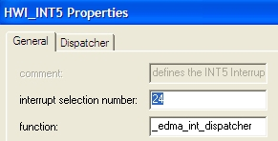
EDMA Interrupt Dispatcher
Here’s the interrupt chain from beginning to end:
1. An interrupt occurs
2. Interrupt Selector
3. HWI_INT5 Properties
HWI_INT5
EDMA3CC_INT (#24)
4. EDMA Interrupt Dispatcher
5. ISR (interrupt handler)
Read IPR bits
Determine which one is set
Call corresponding handler (ISR) in Fxn Table
void edma_rcv_isr (void)
{
SEM_post (&semaphore);
}
How does the ISR Fxn Table (in #4 above) get loaded with the proper handler Fxn names?
Use EDMA3 LLD to program the proper callback fxn for this HWI.

Slide 32
Outline
Overview
Terminology
Examples
Synchronization
Indexing
Events – Transfers - Actions
EDMA Interrupt Generation
Linking
Chaining
Channel Sorting
Architecture & Optimization
Quiz (No Lab)

Slide 33
Linking – “Action” – Overview
T
(xfer config)
Alias: “Re-load” “Auto-init”
Done
Options
T
(xfer config)
Source
1
2
3
4
5
6
B
A
Transfer Count
7
8
9
10
11
8
9
10
11
12
E
(event)
Destination
A
(action)
13
14
15
16
17
18
Index
19
20
21
22
23
24
Cnt Reload
Link Addr
25
26
27
28
29
30
Index
Index
Rsvd
C
Need: auto-reload channel with new config
Ex1: do the same transfer again
Ex2: ping/pong system (covered later)
Solution: use linking to reload Ch config
Concept:
Linking two or more channels together allows the EDMA to auto-reload a new configuration when the current transfer is complete.
Linking still requires a “trigger” to start the transfer (manual, chain, event).
You can link as many PSETs as you like – it is only limited by the #PSETs on a device.
How does linking work?
User must specify the LINK field in the config to link to another PSET.
When the current xfr (0) is complete, the EDMA auto reloads the new config (1) from the linked PSET.
Config 0
Config 1
reload
LINK
LINK
1
NULL
Note: Does NOT start xfr !!

Slide 34
Outline
Overview
Terminology
Examples
Synchronization
Indexing
Events – Transfers - Actions
EDMA Interrupt Generation
Linking
Chaining
Channel Sorting
Architecture & Optimization
Quiz (No Lab)

Slide 35
Reminder – Triggering Transfers
There are 3 ways to trigger an EDMA transfer:
1
Event Sync from peripheral
ER = Event Register (flag)
EER = Event Enable Register (user)
McASP0
EDMA3
RRDY
XRDY
ER
EER
Start Ch Xfr
2
Manually Trigger the Channel to Run
Application
Channel y
ESR = Event Set Register (user)
Set Ch #y;
ESR
Start Ch Xfr
✓
Chain Event from another channel (next example…)
3
Channel x
Channel y
TCCHEN = TC Chain Enable (OPT)
TCCHEN_EN
TCC = Chy
Start Ch Xfr
CER
Let’s do a simple example on chaining…

Slide 36
Chaining – “Action” & “Event” – Overview
T
(xfer config)
Done
Options
T
(xfer config)
Source
1
2
3
4
5
6
B
A
Transfer Count
7
8
9
10
11
8
9
10
11
12
E
(event)
Destination
A
(action)
13
14
15
16
17
18
Index
19
20
21
22
23
24
Cnt Reload
Link Addr
25
26
27
28
29
30
Index
Index
Rsvd
C
Need: When one transfer completes, trigger another transfer to run
Ex: ChX completes, kicks off ChY
Solution: Use chaining to kick off next xfr
Concept:
Chaining actually refers to both both an action and an event – the completed ‘action’ from the 1st channel is the ‘event’ for the next channel
You can chain as many Chan’s as you like – it is only limited by the #Ch’s on a device
Chaining does NOT reload current Chan config – that can only be accomplished by linking. It simply triggers another channel to run.
How does chaining work?
Set the TCC field to match the next (i.e. chained) channel #
Turn ON chaining
When the current xfr (X) is complete, it triggers the next Ch (Y) to run
Ch X
Ch Y
Y
?
TCC
Done ?
TCC
RUN Y
EN
DIS
Chain EN
Chain EN

Slide 37
Example #1 – Simple Chaining
EDMA Chain/Evt
EDMA Channels
EDMA Interrupt Gen
CER
ESR
Ch #
OPT.TCINTEN
OPT.TCC
IPR
IER
0
5
0
5 = 0
7
5 = 0
0
6
1
6 = 0
0
6 = 1
EDMA3CC_GINT
1
7
0
7 = 1
6
7 = 0
0
55
0
55 = 0
55
55 = 0
OPT.TCCHEN
CER
CER = Chain Evt Reg
ESR – Evt Set Reg
TCINTEN = “Final” TCC will interrupt the CPU
TCCHEN = “Final” TCC will chain to next channel
Channel #5
5 = 1
7
0
Triggered manually by ESR
Chains to Ch #7 (Ch #5’s TCC = 7)
0
6 = 0
0
7 = 0
6
1
Channel #7
0
55 = 0
55
Triggered by chaining from Ch #5
Interrupts the CPU when finished (sets TCC = 6)
ISR checks IPR (TCC=6) to determine which channel generated the interrupt
Notes:
Any Ch can chain to any other Ch by enabling OPT.TCCHEN and specifying the next TCC
Any Ch can interrupt the CPU by enabling its OPT.TCINTEN option (and specifying the TCC)
IPR bit set depends on previous Ch’s TCC setting
Notes:
Instructor – It is really key here to make sure all the students understand this example from beginning to end. Take it slow and show the entire path and logic. Show how TCINTEN/TCCHEN/TCC interact to give the desired result. Start with the “goal” of Channel #5 and Channel #7. Walk them through the path showing how each option and bitfield helps us attain our goal. Make sure they clearly understand what the fields mean on the right. Then, cover the Notes: section. Once they all understand this example, the next two will be simpler.

Slide 38
Outline
Overview
Terminology
Examples
Synchronization
Indexing
Events – Transfers - Actions
EDMA Interrupt Generation
Linking
Chaining
Channel Sorting
Architecture & Optimization
Quiz (No Lab)

Slide 39
Channel Sort – “Transfer Config” – Overview
T
(xfer config)
Done
Options
T
(xfer config)
Source
1
2
3
4
5
6
B
A
Transfer Count
7
8
9
10
11
8
9
10
11
12
E
(event)
Destination
A
(action)
13
14
15
16
17
18
Index
19
20
21
22
23
24
Cnt Reload
Link Addr
25
26
27
28
29
30
Index
Index
Rsvd
C
Need: De-interleave (sort) two (or more) channels
Ex: stereo audio (LRLR) into L & R buffers
Solution: Use DMA indexing to perform sorting automatically
Concept:
In many applications, data comes from the peripheral as interleaved data (LRLR, etc.)
Most algos that run on data require these channels to be de-interleaved
Indexing, built into the EDMA3, can auto-sort these channels with no time penalty
How does channel sorting work?
User can specify the ‘BIDX and ‘CIDX values to accomplish auto sorting
PERIPH
MEM
L0
EDMA
L0
R0
L1
BIDX
L2
L1
R1
CIDX
R0
L2
R1
R2
R2

Slide 40
Outline
Overview
Terminology
Examples
Synchronization
Indexing
Events – Transfers - Actions
EDMA Interrupt Generation
Linking
Chaining
Channel Sorting
Architecture & Optimization
Quiz (No Lab)

Slide 41
EDMA Architecture
Periphs
E63
E1
E0
Evt Reg (ER)
Queue
CC
TC
PSET 0
Evt Enable Reg (EER)
Q0
PSET 1
TC0
Q1
. . .
TR Submit
TC1
Evt Set Reg (ESR)
DATA
SCR
Q2
TC2
PSET 254
Chain Evt Reg (CER)
Q3
Early TCC
TC3
PSET 255
EDMAINT
Int Pending Reg – IPR
Completion Detection
Normal TCC
Int Enable Reg – IER
SCR = Switched Central Resource
EDMA consists of two parts: Channel Controller (CC) and Transfer Controller (TC)
An event (from periph-ER/EER, manual-ESR or via chaining-CER) sends the transfer to 1 of 4 queues (Q0 is mapped to TC0, Q1-TC1, etc. Note: McBSP can use TC1 only)
Xfr mapped to 1 of 256 PSETs and submitted to the TC (1 TR – transmit request – per ACNT bytes or “A*B” CNT bytes – based on sync). Note: Dst FIFO allows buffering of writes while more reads occur.
The TC performs the transfer (read/write) and then sends back a transfer completion code (TCC)
The EDMA can then interrupt the CPU and/or trigger another transfer (chaining – Chap 6)
Notes:
A TR (transmit request) can be either ACNT bytes (for A-sync) or ACNT*BCNT bytes for AB-sync.
Queues are 16 events deep.
Reference is SPRU966
In the U/G, it does show using watermark and threshold. You have debug visibility into the Queue RAM.
There is a EDMA performance app note. SPRAAG8. This might help answer many questions from students. It is ON their lab workstation and will eventually go onto their USB key.

Slide 42
EDMA Performance – Tips, References
Spread Out the Transfers Among all Q’s
Don’t use the same Q for too many transfers (causes congestion)
Break long non-realtime transfers into smaller xfrs using self-chaining
Manage Priorities
Can adjust TC0-3 priority to the SCR (MSTPRI register)
In general, place small transfers at higher priorities
Tune transfer size to FIFO length and bus width
Place large transfers on TCs w/larger FIFOs (typically TC2/3)
Place smaller, real-time transfers on TC0/1
Match transfers sizes (A, A*B) to bus width (16 bytes)
Align src/dst on 16-byte boundaries
References
Programming EDMA3 using LLD (wiki) + examples (see next slide…)
TC Optimization Rules (SPRUE23)
EDMA3 User Guide (SPRU966)
EDMA3 Controller (SPRU234)
EDMA3 Migration Guide (SPRAAB9)
EDMA Performance (SPRAAG8)
Notes:
"Self-chaining" means that TCC is set to the same value as the channel that is operating. If you are using channel 9 and set TCC to 9 and enable chaining then you are using "self-chaining".
Generally, "self-chaining" will be used, for example, to break a 16384-byte transfer into 16 1024-byte transfers. For this, you would use ITCCHEN=1 but probably not TCCHEN=1, and change the parameters from, say
ABSYNC
ACNT=1024
BCNT=16
CCNT=1
To
ASYNC
ACNT=1024
BCNT=16
CCNT=1
In the first case, one sync event is all that is required to make the whole 16x1024 transfer happen. In the second case, only 1024 bytes will be transferred when a sync event comes in to start it, so an intermediate TCC can be generated to come back and trigger a new sync event to the same channel. This repeats after each 1024 bytes (ACNT) are transferred, then ends if TCCHEN=0.
Another useful example is to actually get a 3-D transfer to occur. Since there is no way for a single sync event to make a 3-D transfer happen (only ASYNC and ABSYNC exist, no ABCSYNC), you can use "self-chaining" to get an new sync event at the end of each ABSYNC set that decrements CCNT. Again, you would use ITCCHEN-1 and TCCHEN-0.
If you link AND chain (to yourself), the link is guaranteed to occur before you chain.

Slide 43
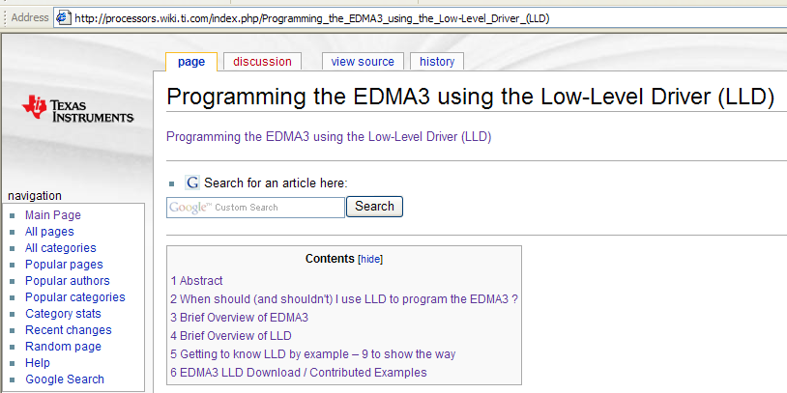
EDMA3 LLD Wiki…
Download the detailed app note…
Use the examples to learn the APIs…
Notes:
"Self-chaining" means that TCC is set to the same value as the channel that is operating. If you are using channel 9 and set TCC to 9 and enable chaining then you are using "self-chaining".
Generally, "self-chaining" will be used, for example, to break a 16384-byte transfer into 16 1024-byte transfers. For this, you would use ITCCHEN=1 but probably not TCCHEN=1, and change the parameters from, say
ABSYNC
ACNT=1024
BCNT=16
CCNT=1
To
ASYNC
ACNT=1024
BCNT=16
CCNT=1
In the first case, one sync event is all that is required to make the whole 16x1024 transfer happen. In the second case, only 1024 bytes will be transferred when a sync event comes in to start it, so an intermediate TCC can be generated to come back and trigger a new sync event to the same channel. This repeats after each 1024 bytes (ACNT) are transferred, then ends if TCCHEN=0.
Another useful example is to actually get a 3-D transfer to occur. Since there is no way for a single sync event to make a 3-D transfer happen (only ASYNC and ABSYNC exist, no ABCSYNC), you can use "self-chaining" to get an new sync event at the end of each ABSYNC set that decrements CCNT. Again, you would use ITCCHEN-1 and TCCHEN-0.
If you link AND chain (to yourself), the link is guaranteed to occur before you chain.

Slide 44
Outline
Overview
Terminology
Examples
Synchronization
Indexing
Events – Transfers - Actions
EDMA Interrupt Generation
Linking
Chaining
Channel Sorting
Architecture & Optimization
Quiz (No Lab)

Slide 45
Chapter Quiz
Name the 4 ways to trigger a transfer?
Compare/contrast linking and chaining
Fill out the following values for this channel sorting example (5 min):
PERIPH
MEM
16-bit stereo audio (interleaved)
Use EDMA to auto “channel sort” to memory
L0
L0
R0
L1
ACNT: _____
BCNT: _____
CCNT: _____
‘BIDX: _____
‘CIDX: _____
L1
L2
R1
L3
BUFSIZE
L2
R0
R2
R1
L3
R2
R3
R3
Could you calculate these ?

Slide 46
Chapter Quiz
Name the 4 ways to trigger a transfer?
Compare/contrast linking and chaining
Fill out the following values for this channel sorting example (5 min):
Manual start, Event sync, chaining and (QDMA trigger word)
linking – copy new configuration from existing PARAM (link field)
chaining – completion of one channel triggers another (TCC) to start
PERIPH
MEM
16-bit stereo audio (interleaved)
Use EDMA to auto “channel sort” to memory
L0
L0
R0
L1
ACNT: _____
BCNT: _____
CCNT: _____
‘BIDX: _____
‘CIDX: _____
2
L1
L2
2
R1
L3
BUFSIZE
4
L2
R0
R2
R1
8
L3
R2
-6
R3
R3
Could you calculate these ?

Slide 47


Slide 48
EDMA3 Terminology
3-dimensional transfer consisting of ACNT, BCNT and CCNT:
ACNT = Array = # of contiguous ACNT bytes (16-bit unsigned, 0-65535)
BCNT = Frame = # of ACNT arrays (16-bit unsigned, 0-65535)
CCNT = Block = # of BCNT frames (16-bit unsigned, 0-65535)
Minimum transfer is an array of ACNT bytes
Total transfer count = ACNT * BCNT * CCNT
ACNT Bytes
Frame 1
Array1
Array2
Array BCNT
Frame 2
CCNT
Frames
Array1
Array2
Array BCNT
Frame CCNT
Array1
Array2
Array BCNT
BCNT Arrays

Slide 49
Triggering an EDMA Transfer to Start
Each of the 64 DMA channels can be triggered by any of the following:
Event Triggering (from a peripheral) – EER/ER
{6455 values given. Check your datasheet}
Periphs
E63
E1
E0
McBSP 0/1 (REVT0/1, XEVT0/1)
Utopia (UREVT/XEVT)
Timer 0/1 (TEVTLO/HI 0/1)
GPIO (GPINT[15:0])
SRIO (RIOINT1)
VCP2 (VCP2REVT/XEVT)
TCP2 (TCP2REVT/XEVT)
HPI/PCI (DSPINT)
I2C (ICREVT/XEVT)
Evt Reg (ER)
Evt Enable Reg (EER)
Each event is tied to a specific DMA channel (e.g. XEVT1 → Ch 14) and can be enabled/disabled via EER register
Note: excerpt from SPRU966 – Channel Sync Events
Manual Triggering - ESR
CPU writes a “1” to the corresponding bit of the Event Set Register (ESR)
Evt Set Reg (ESR)
Chain Triggering - CER
Used to execute multiple TRs upon receipt of a single event
Ex: EVT_{x} triggers Ch0, Ch0 completes and triggers Ch1 (TCC=1)
Chained events are captured in the Chain Event Register (CER)
Chain Evt Reg (CER)
Notes:
For the Channel Controller (CC), there is a priority between ESR, ER and CER:
#1 – ESR
#2 – CER
#3 – ER
Debug – never see ER get set. It gets set, then cleared very quickly. So, a trick is to clear the EER bit during debug so that you can see the ER bit get set.

Slide 50
Transfer Complete Code (TCC)
31
18
17
12
11
10
0
Options Reg
TCC
TCCMODE
Ch 0-63
NORMAL
EARLY
TCC is generated when a transfer completes. This is referred to as the “Final TCC”.
TCC can be used to trigger an EDMA interrupt and/or another transfer (chaining)
Each TR below is a “transfer request” which can be either ACNT bytes (A-sync) or ACNT * BCNT bytes (AB-sync). Final TCC only occurs after the LAST TR.
Final TCC can be generated at either of two different times:
NORMAL mode (after peripheral acknowledgement)
EVTx
EVTx
EVTx
EVTx
TCC
TR
TR
TR
TR
TC Ack
EARLY mode (after submitting the last TR to TC)
EVTx
EVTx
EVTx
EVTx
TCC
TR
TR
TR
TR

Slide 51
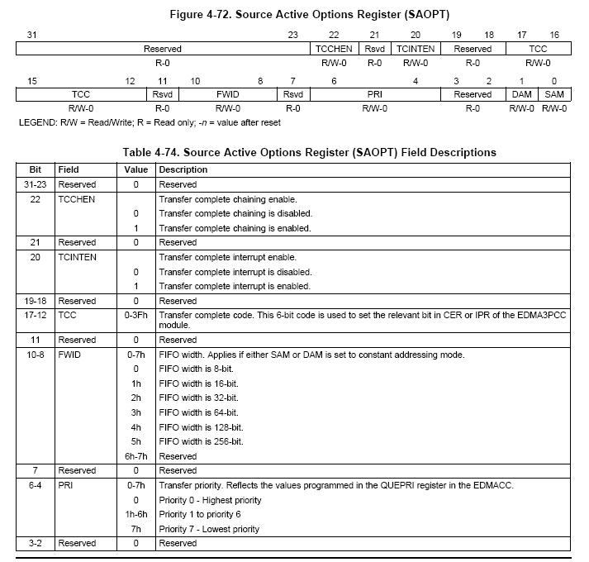
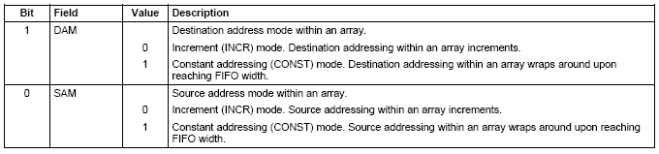
OPTions Register Details

Slide 52
Counter Reload
1 | 2 | 3 | 4 | 5 | 6 | 7 | 8 | 9 | 10
1 | 2
1 | 2
M
cBSP
EDMA
Left:
Right:
What happens when BCNT goes to zero?
There’s a register for this
BCNT.ACNT
2
2
DST.BIDX.CIDX
20
-18
BCNTRLD.LINK
2
CCNT
10
Src Addr
McBSP
Dst Addr
Left

Slide 53
Outline
MainHighlight
MainNormal
SubHighlight
SubNormal

